Slide 1
Aerothermochemistry and Combustion
Introduction – DAY 4
Kumaresh

Slide 2
Contents
Introduction to OpenFOAM and importance
Exercise – 4

Slide 3
OpenFOAM - Introduction
OpenFOAM® stands for Open Source Field Operation and Manipulation.
OpenFOAM® is first and foremost a C++ library used to solve partial differential equations (PDEs), and ordinary differential equations (ODEs).
It comes with several ready-to-use or out-of-the-box solvers, pre-processing utilities and post-processing utilities.
It is licensed under the GNU General Public License (GPL).That means it is freely available and distributed with the source code.
OpenFOAM (Version v2306) is implemented in Ubuntu (version 22.04)
ParaView (version 5.1.0) for post-processing.

Slide 4
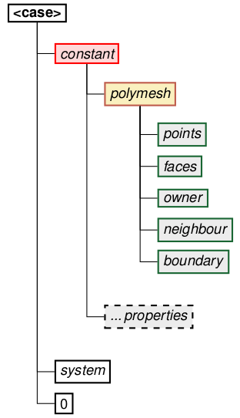
OpenFOAM – Directory Structure
constant: This directory contains the information which remains constant throughout the simulation. It contains the following:
1.1 polymesh: Contains all the mesh information including:
points → nodal positions
faces → face connectivity neighbor boundary
owner → owner cell labels
neighbor → neighbor cell labels
boundary → boundary information
1.2 properties: Files which specify physical properties for a particular application. Eg: gravity, viscosity, thermal and transport properties etc.

Slide 5
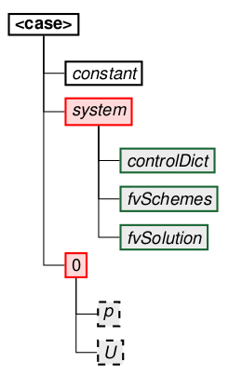
OpenFOAM – Directory Structure
2. system: This directory contains all the parameters associated with the solution procedure. It contains at least the following files:
2.1 blockmeshDict:
The principle behind blockMesh is to decompose the domain geometry into a set of 1 or more three dimensional, hexahedral blocks. This section describes the mesh generation utility, blockMesh, supplied with OpenFOAM. The blockMesh utility creates parametric meshes with grading and curved edges. BlockMesh reads this dictionary, generates the mesh and writes out the mesh data to points and faces, cells and boundary files in the same directory.
2.2 controlDict: Specifies the run control parameters such as start/ end time, time step, write interval etc.
2.3 fvSchemes: Contains the finite volume discretization schemes used for the solution procedure such as spatial and temporal discretizations.
2.4 fvSolution: Contains equation solvers, algorithm controls and tolerances for the implicit solvers.
3. 0: The ’0’ directory corresponds to zero time. It contains the initial and boundary conditions for variables (i.e. pressure p, velocity U) in individual files

Slide 6

CFD Developers
Developers are the ones who write code on the back end.
To make it simple for CFD amateur students, let's say ANSYS Fluent and Star CCM are written by developers (by writing code at the back end), so we could easily use them as black box (GUI) tools.
Developers are the key to the development of technology.

Slide 7

Is it good to be a black box user or a developer ?
A developer can handle anything from scratch. That brings confidence by capable of solving any puzzles.
Understanding the logic is an art, so being a developer helps know exactly what and how to do.
It's good to be a black box user in the beginning to understand the basic ideas/physics, but in order to route your future, trust me, developers can handle it better.

Slide 8

How to grow as a developer ?
Work with passion
Face the hurdles and don’t get tired of it
Never lose the joy of programming
Test your skills in open-source projects
Read code and do code reviews
Learn from your colleagues and mentors
Share your knowledge

Slide 9
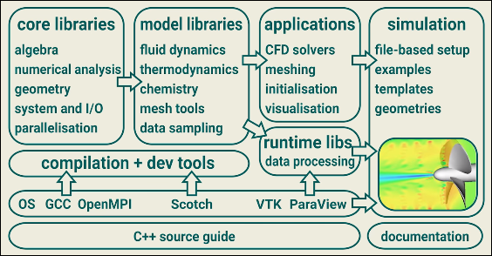
How to grow as a developer ? → OpenFOAM
OpenFOAM is a software framework (or toolbox) that you can use to develop Finite Volume Method based solvers for general continuum mechanics problems mostly for fluid flow and heat transfer.
It is a huge library of about 1.5 million lines of C++ code located in hundreds of files.
You can use this toolbox to develop Computational Fluid Dynamics (CFD) solvers.

Slide 10
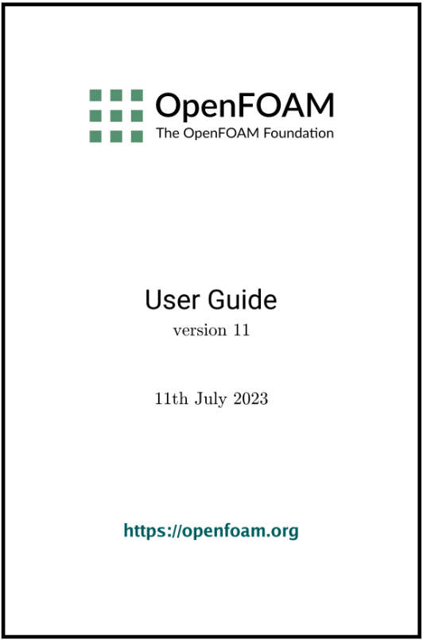
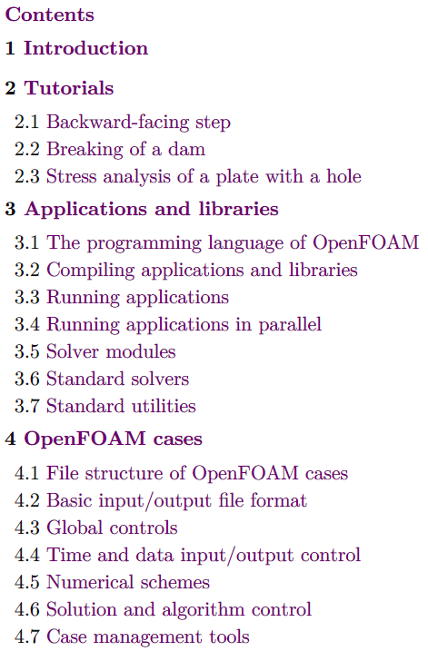
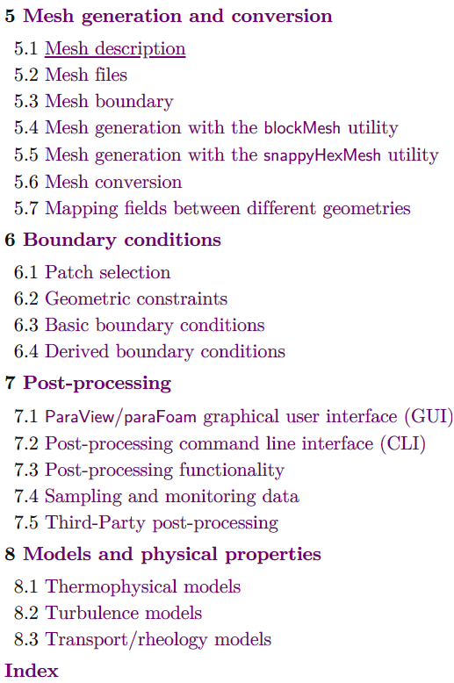
The OpenFOAM User Guide provides an introduction to OpenFOAM, through some basic tutorials, and some details about the general operation of OpenFOAM. OpenFOAM is a collection of approximately 150 applications built upon a collection of approximately 150 software libraries (modules).
OpenFOAM User GUIDE

Slide 11
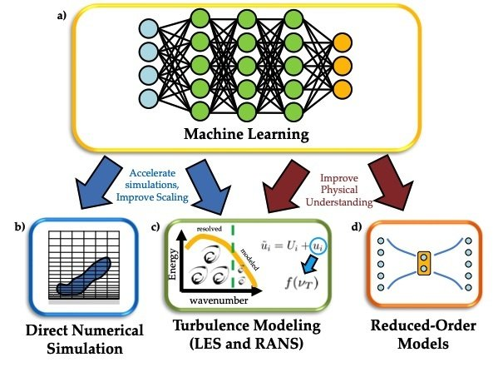
Machine Learning in CFD
To understand certain critical parameters in any physical phenomenon, data optimisation can be implemented by machine learning algorithms.
By definition, machine learning is a branch of artificial intelligence (AI) and computer science that focuses on the use of data and algorithms to imitate the way that humans learn, gradually improving its accuracy.
The data optimisation saves simulation time to interpret the phenomenon by improving accuracy. This is in the current developing stage of this technology world.
This improvisation will assist steel industry technologies in prospering and creating a better future.

Slide 12
What is OpenFOAM and importance ?
Notes:
https://www.youtube.com/watch?v=r5ts2FLCA7U

Slide 13
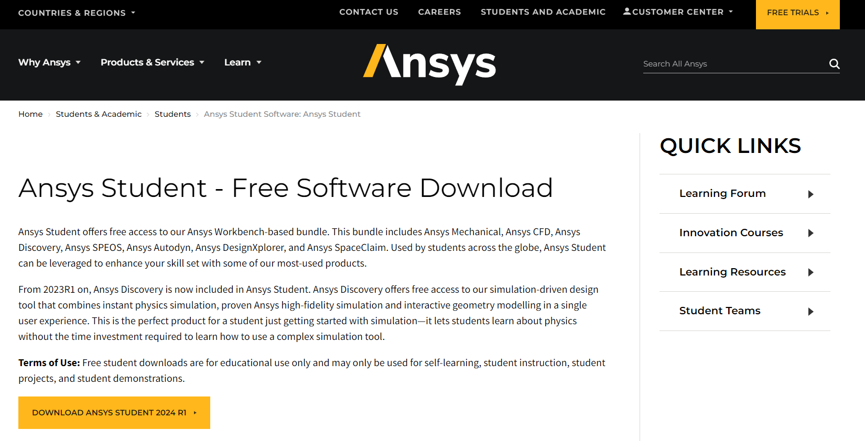
ANSYS Student version installation

Slide 14
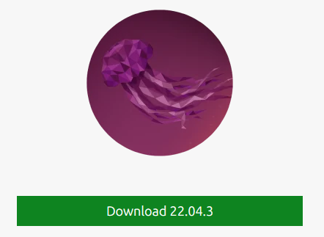



OpenFOAM Installation
Preconfiguration packages:
https://1drv.ms/f/s!AqT2YEB97-1RgP8MtsMPqoOGsq4ddg?e=IocXv0
List
Virtual Box [to create virtual machines]
Operating System: Ubuntu 22.04 [Install OpenFOAMv2306 & Octave]
AnyDesk [For remote access]
Discussion forum:
https://github.com/Kumaresh0402/AerothermochemistryAndCombustion/discussions

Slide 15
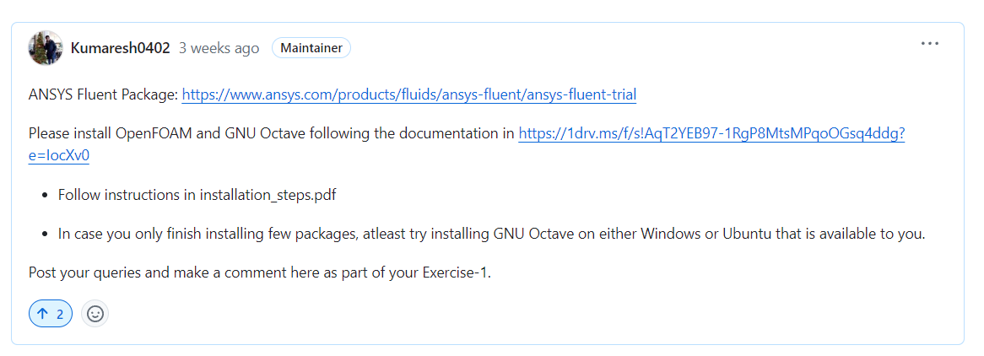
[Exercise-4] Package installations (ANSYS and OpenFOAM)
https://github.com/Kumaresh0402/AerothermochemistryAndCombustion/discussions/2

